Slide 1
Apigee Insights Anant Jhingran @jhingran

Slide 2
Agenda
What’s new in the world of Digital Transformation – change and context
New analytics capabilities needed to address this changing world
Agility in Analytical Process
Insights Architecture
Insights Services

Slide 3
What’s New

Slide 4







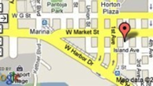















Self-Optimizing Digital Business
Optimize your digital business
by making
every customer interaction smarter
across every digital channel,
in real time,
using all
relevant contextual business insights
Self-Optimizing Digital Business
API
Your Digital Assets
API
API
API

Slide 5
Pace of change is increasing
After an initial startup, we saw > 1 new API every 10 days
After 150 days, we observed slowdown in less than 10% of organizations
Median number of APIs per organization: 14
Notes:
Pace of change is accelerating and will increase even further; need a way to quickly adapt to changing business needs

Slide 6
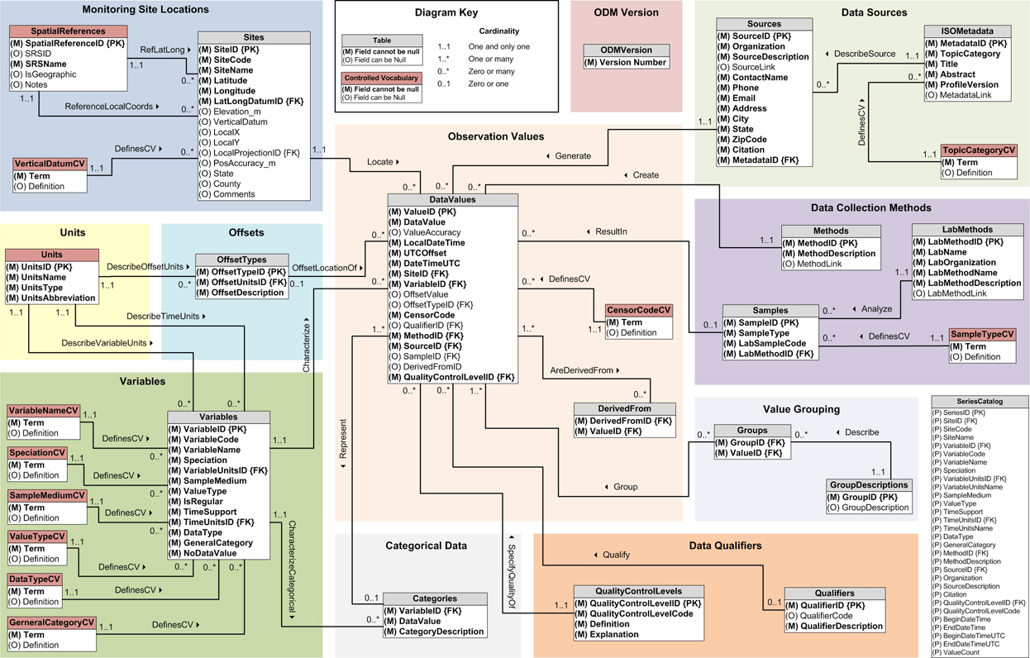
Data Modeling is dead, so is ETL

Slide 7


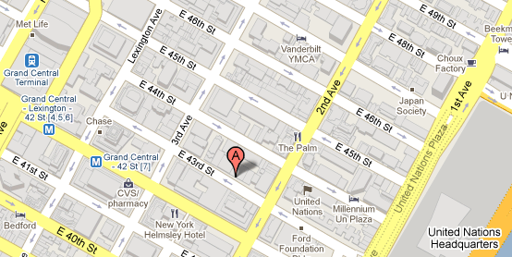

New rapidly changing contextual signals occur
User | Developer
Time | Location
Notes:
Main Point:
Establish our ability to find signals from the noise
Script
Insights can help analyze various external contexts identify signals that drive value. Context comes in many flavors – social, environmental, socio economic, transactional etc.
We’re showing examples of 4 contexts here
For example, when analyzing the user context, we can look at their Facebook activity or Twitter activity or their prior transaction history from an internal system
Transition
We can use these signals to deliver business insights that help you better understand your business

Slide 8









Need for a new Big Data Platform
Apigee Insights
All Channels
User Engagement
Developer Adoption
API
Information
Apigee Edge
Correlations
Conversions
Segmentation
Anomalies
Time Series
External
and
Internal Context
All Backends

Slide 9
Business and Technical Problems

Slide 10
Contextual Business Insights
Business Growth
User Engagement
Developer Adoption
API Information
Notes:
Business Growth
Are our APIs driving business growth?
What external factors drive business growth? Do we face a blind spot?
What is the demographic profile of our most active users?
Developer Adoption
Are we attracting the right developers?
What do my developers do outside my API program?
How productive are my developers in app creation?
User Engagement
What do my end users do outside my apps?
Are we building the right apps? APIs?
How can we better serve the needs of our users?
API Adoption
Who uses APIs? Which apps? From where?
What pieces of data is being used?
Are my APIs easy to consume? Do I need to redesign them?

Slide 11
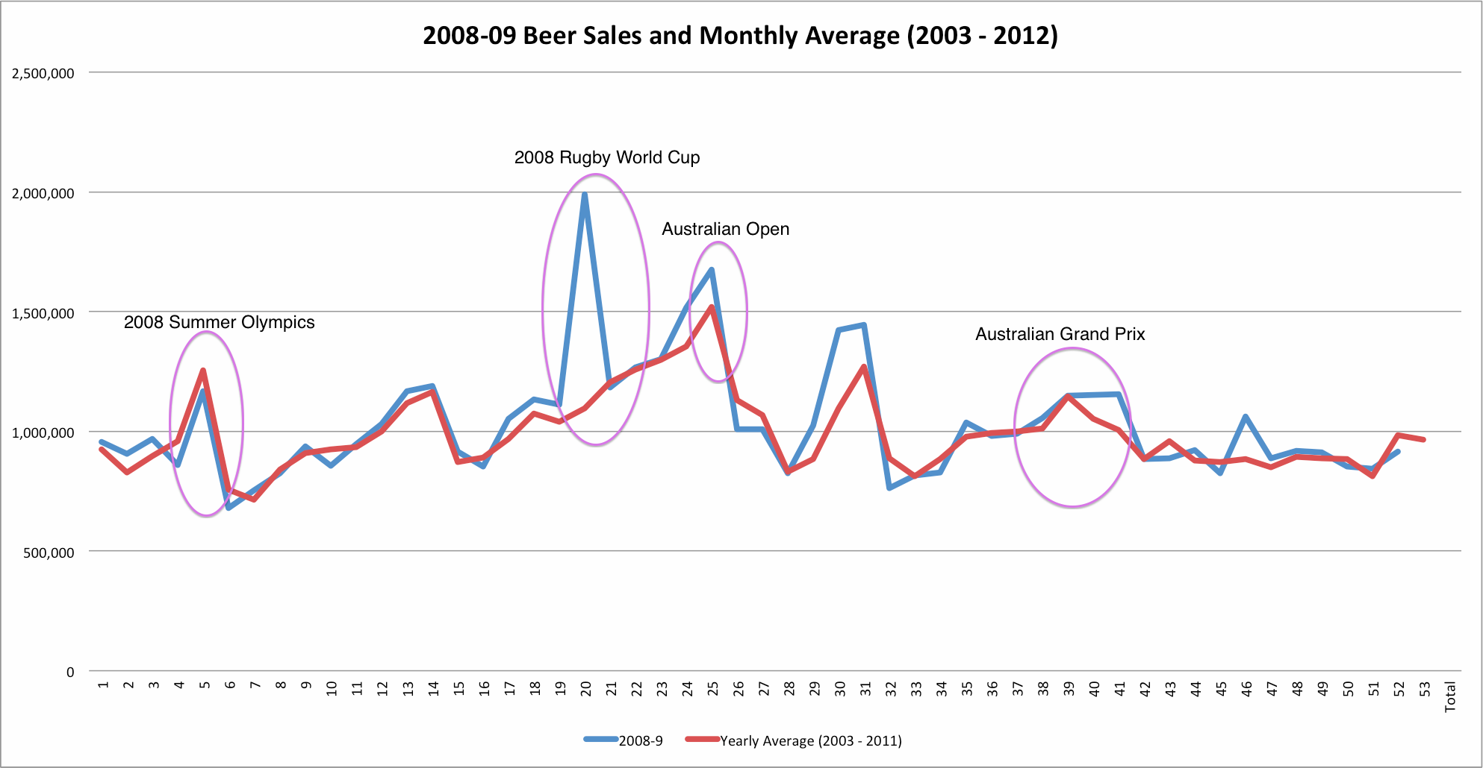
Sporting Events and Beer Consumption in AU
Adjust on-hand stock of beer (by brand and packaging) for each type of sporting event
2008 Rugby World Cup
2008 Summer
Olympics
Notes:
The context is
Average Beer sales by Week (event series)
Sporting Events (event series)
The analysis is
Time Window based Anomaly Detection

Slide 12
User Shopping Behavior
Send personalized offers to at-risk customers based on online, mobile, and offline interactions
/product
/search
/buy
/storelocator
/findinstore
< 3 days
< 1 day

Slide 13
Speeding up the Analytical Process

Slide 14
Speed up delivery of business insights
Visualize
Collect
Analyze
Act
CAVA

Slide 15
Collect and Act faster
Action
External Context
Apigee Insights
Internal Context
All Digital Channels
App Analytics
Apigee
Edge
Developer Analytics
Data
API Analytics
15
Notes:
Main Point
Establish how Apigee Insights works with Apigee Edge to help you transform into a self-optimizing business
Script
You currently use Apigee Edge which enables you to establish a digital presence.
Apigee Insights takes all the analytics data from Apigee Edge along with relevant contextual data that is both external to your firm or could live in internal systems. Insights thus helps you develop a single view of your customers across all digital channels. It uses that data to deliver business insights that identify opportunities to optimize your business.
And it can drive actions through Apigee Edge and all your digital channels to help you optimize every customer interaction across every digital channel in real time.
Transition
TBD

Slide 16
Analyze faster: Abstractions
Turnkey Solution
Entities, Events & Analytics Libraries
Speed of Delivery
Map/Reduce
File System
Flexibility

Slide 17
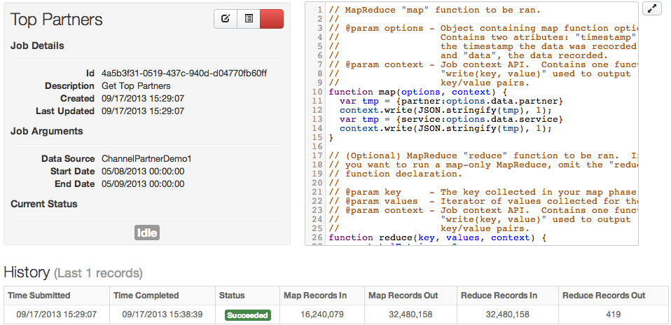
Analyze faster: Widely used technologies
Easy access to skills (Javascript) accelerate development time

Slide 18
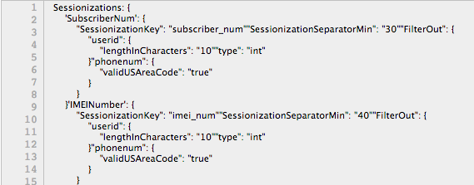
Analyze faster: Configuration, not code

Slide 19
Architecture

Slide 20
Insights: Architectural Components
Visualization Engine
Configuration Engine
JavaScript Engine
Apigee Edge
Core Execution Engine and Analytics Libraries
Pre-Built Connectors
API
Entities and Events Collection Engine
Big Data Stack

Slide 21
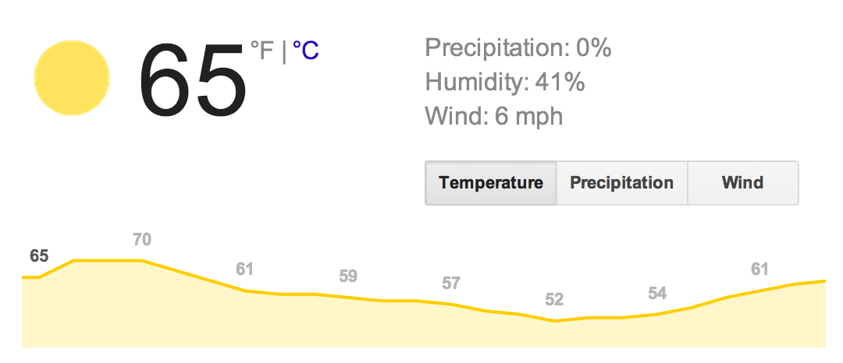

Demo: Retail Personalization
External Context
Apigee Insights
All Digital Channels
Data
Action
Internal Context

Slide 22
Demo

Slide 23
Insights Services

Slide 24
Engagement Workflow
Kickoff
Data
Analysis
Readout
Insights

Slide 25
Analysis Process
Take core findings through multiple dimensions to deliver hidden insights
Data
Sessions
MapReduce
Insights
Service, Errors, Time, APIs, Status, etc.
Raw customer data

Slide 27
Appendix

Slide 28





Apigee Digital Business Platform
Insights
Big Data
Mobile
ESB, SOA,
App Servers,
Databases
Point of Sale
Edge
Apps, APIs, Analytics
Partner
Web
Backend Services
Apps
Exchange
API Networks

Slide 29
Data Science Engagement Workflow
Work with the customer to understand
What data they have available and its schema
Their technical and business goals (successes, failures, metrics, etc.)
Determine if there are other relevant external data sets
Obtain a set of historical data for POC
Load the data into a platform instance on AWS using the bulk file importer
Data files are staged in S3
Currently support csv, web log formats but can add easily add others
Files are stored in HDFS
Data can be loaded into HDFS either
As time series (time stamp with an event payload)
Or as entities (a unique identifier plus relevant characteristics)
29

Slide 30
Data Science Engagement Workflow
View data samples in a Series Manager UI
Run MapReduce jobs in javascript (UI or via app specification)
Common jobs:
Aggregation – group the data in time and by dimensions
Sessionization – group the data per end user interaction
Bringing in context (joins with other data sets)
Results can be written as
Time series
Entities
As a final result in JSON
Final results can be downloaded via a REST API:
/jobs/{jobId}/{runId}/results
30

Slide 31
Data Science Engagement Workflow
Final results can be visualized in Excel or any other plotting program
For each analysis, we identify a result and an action or recommendation based upon the result
Periodic update reports are given to the customer
31

